Slide 1
New Zealand GDP Forecasting
Presented by : Dan Dai

Slide 2
Introduction
Background
The Investor wants to know if NZ is worth investing
Build a Machine learning model to analyse NZ economy growth potential
Goal of the project
Is NZ’s Economy safe to invest
What factors would affect GDP growth
What machine learning model can forecast GDP growth
Which is the best Machine learning model
Key Analysis
Exploration Data Analysis
Machine Learning Model Comparison(ARIMA and Linear Regression)

Slide 3
ABOUT Data
Data source from the World Bank
Collection of Time-dependent yearly data to analyse patterns in the past data to make future forecasting
Target Variable: New Zealand GDP
Features: Time, Agriculture, Service, Manufacturing, Consumption expenditure, Inflation and Unemployment
Feature engineering to make the data useable, null values were filled
Limitations: small sample with only about 50 rows of yearly data, quarterly data not available

Slide 4
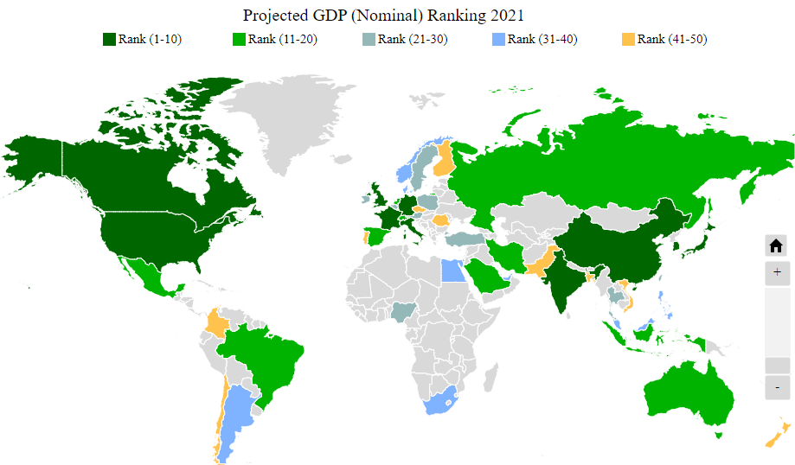
Overall view of World gdp
What does GDP mean for Investors
Total GDP(Nominal)
US Rank 1| NZ Rank 50
GDP per capital
US Rank 6 | NZ Rank 21
GDP Growth Rate
US 5.97% | NZ 5.06%
OECD
38 Developed Countries

Slide 5
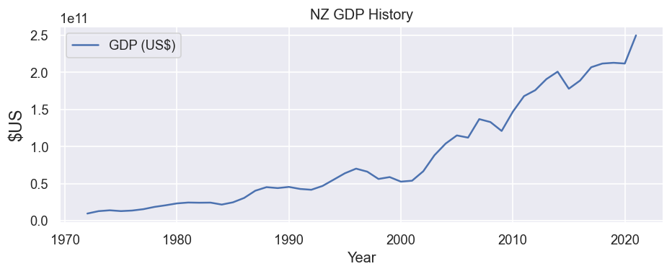
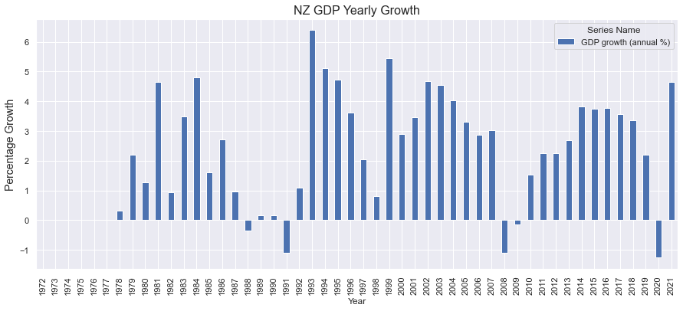
New Zealand gdp growth
Stable growth through the years
doubled from 2000-2003
doubled from 2003-2013
Most of the year is in positive growth
2008 financial crisis and 2020 Covid-19

Slide 6
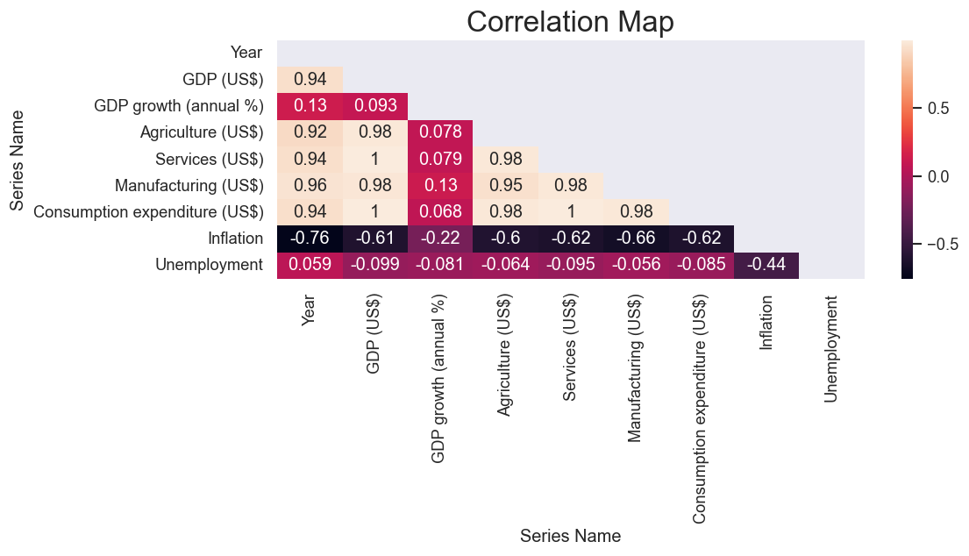
Correlation
Factors that affect GDP the most
Manufacture, service and Agriculture, consumption have the highest correlation with Total GDP
Inflation and Unemployment has a negative correlation with GDP

Slide 7
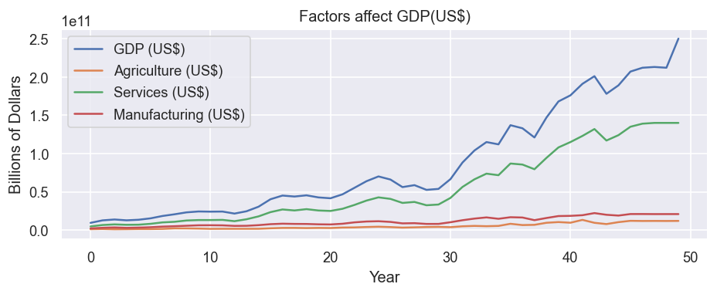
GDP components
NZ economy largely relies on the service sector
Agriculture and Manufacturing only have small amount of growth in the past 50 years

Slide 8
Arima Model assumptions
Data for ARIMA model needs to be Stationary
With trend or seasonality are not stationary
Detrend and difference to adjust data to stationary
Seasonal Adjustments if necessary
ADF Test to test Null Hypothesize to find out if data is Stationary

Slide 9

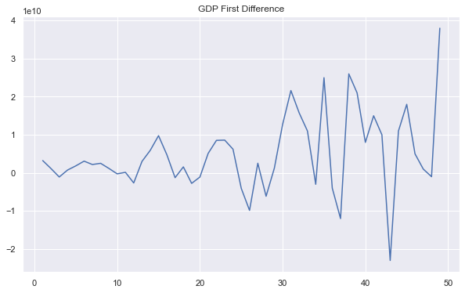

Arima Model adf TEST
Original Data Test Result
First Difference Test Result

Slide 10
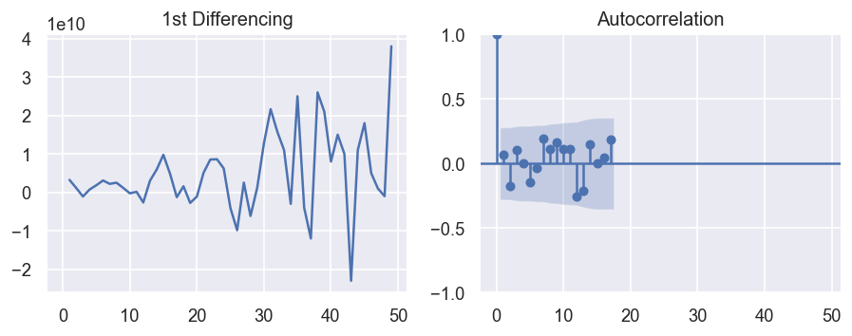
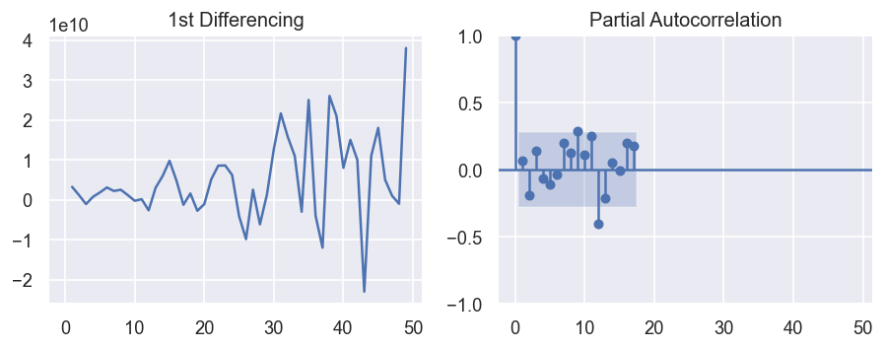
Arima MODEL TUNING
Model Parameters p,q,d
ACF charts to work out best Parameter of AR model lags p=1
PACF chart to work out the best parameter of MA model lags q=1
d means the degree of difference, which is determined by ADF testing d=1

Slide 11
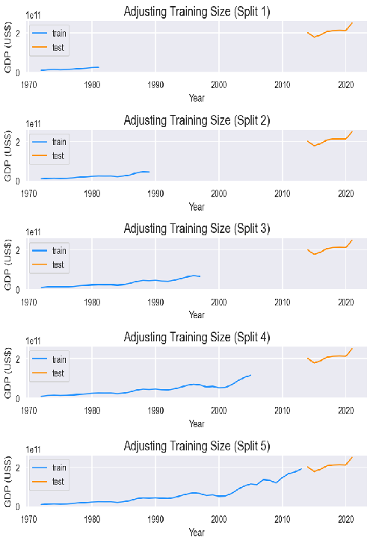
Arima model Cross validation
Time series split
Use default 5 splits
Test data from the 42nd which is the year of 2014
Use Train data to fit the model and test data to do the forecasting

Slide 12
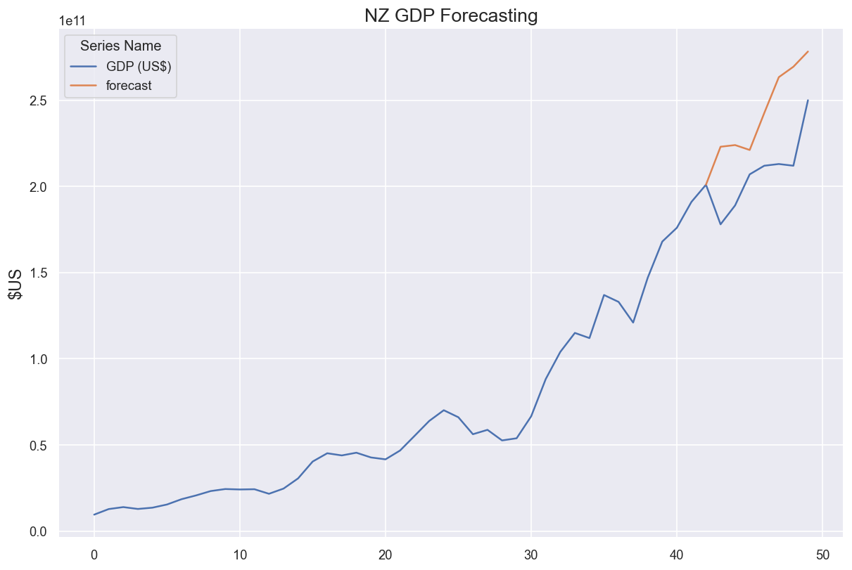
Arima model Forecasting
Use train and test data to build the final forecasting model
Model forecast GDP growth from the year 2014
RMSE Value 206.6 billion

Slide 13
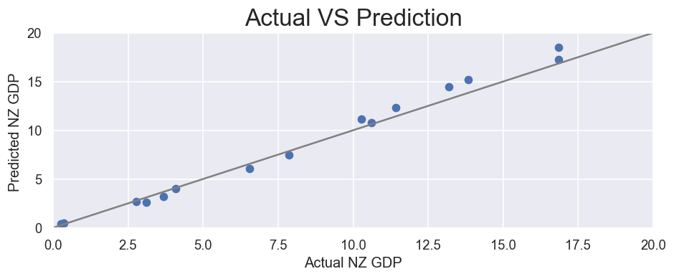
Linear Regression Model
Outcome variable : GDP
Responsible variable: All other features expect Year
All features selected, data normalized
Train and test the database on a 30% split
Linear regression model has fit the line perfectly
RMSE Value 0.77

Slide 14
Conclusion
NZ is a good place to invest with GDP expected to keep on growing in the next few years
variety of factors affect the growth of GDP including Services, consumption, agriculture sector
Both ARIMA and Linear regression model can be used to predict GDP growth
Linear regression model has outperformed ARIMA model with Smaller RMSE value

Slide 15
Recommendation
NZ is recommended place to invest with next year’s GDP expected to grow at about 5%
Invest in the service sector as it is highly correlated to GDP, you would expect a similar return of at least 5%
Inflation is at its highest in past 30 years, do not invest in the cash fund
Linear Regression model is recommended for GDP growth forecasting
In order to improve ARIMA model, quarterly data could be used to have more accurate seasonal adjustment

Slide 16

THANK YOU! QUESTIONS?

